Slide 1
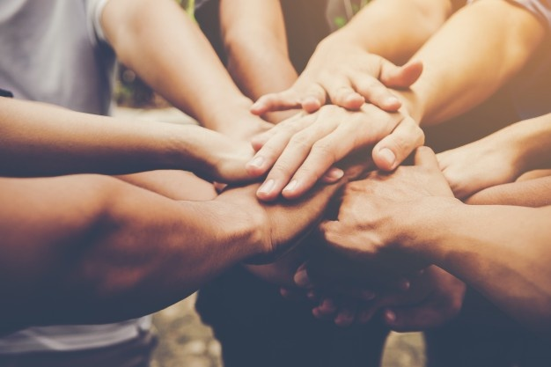
Welfare of people
Lets Help People
U1910275, U1910232, U1910071, U1910278, U1910245
13-March 2020 Y.

Slide 2
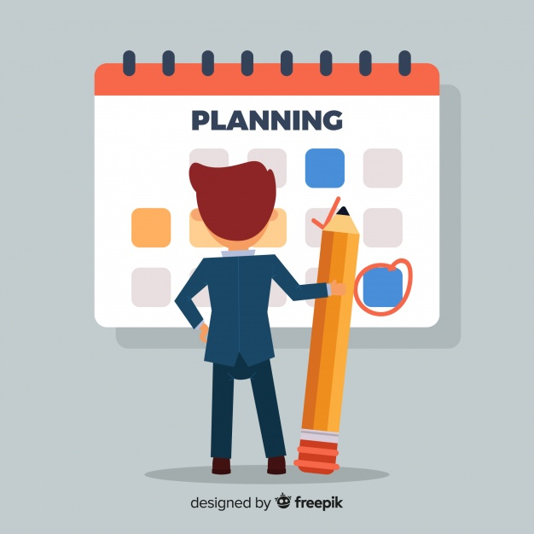
Content
Our presentation will include:
Overview of Design process
Gantt Chart
Design Variables
QFD
Conceptual design
Decision-making matrix
Final Design
Evaluation

Slide 3
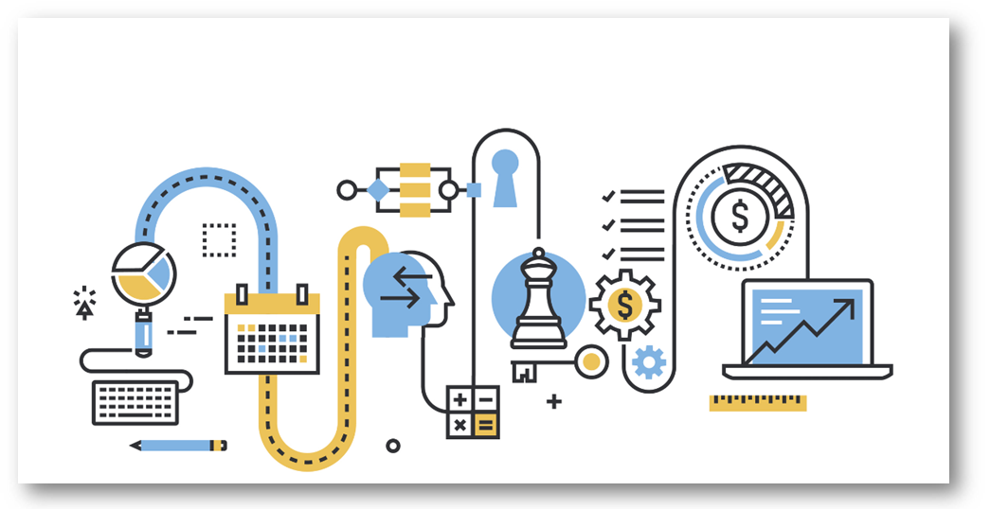
Overview Of Design Process
How did we managed this task?

Slide 4
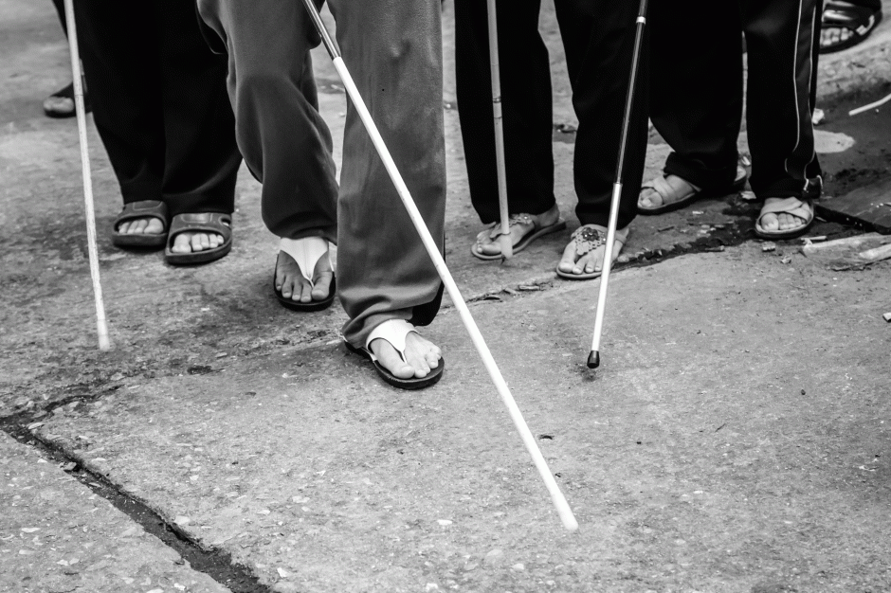
Consumer Complaints
Blind and Deaf people have got some issues
Fear of Falling
Uncomfortableness

Slide 5

Solution
Biomimicry helps us a lot
The additional built in 4 legs help the user stabilize and have less chance to fall
The stick with sensor can be used as a regular stick(used by lame people), for comfortableness.

Slide 6
Consumer Complaints
Blind and Deaf people have got some issues
Location Issues
Issues with walking on different surfaces

Slide 7

Solution
With the help of GPS the loved ones will know the location of the user
The outer surface of those legs will be covered with elastic.

Slide 8
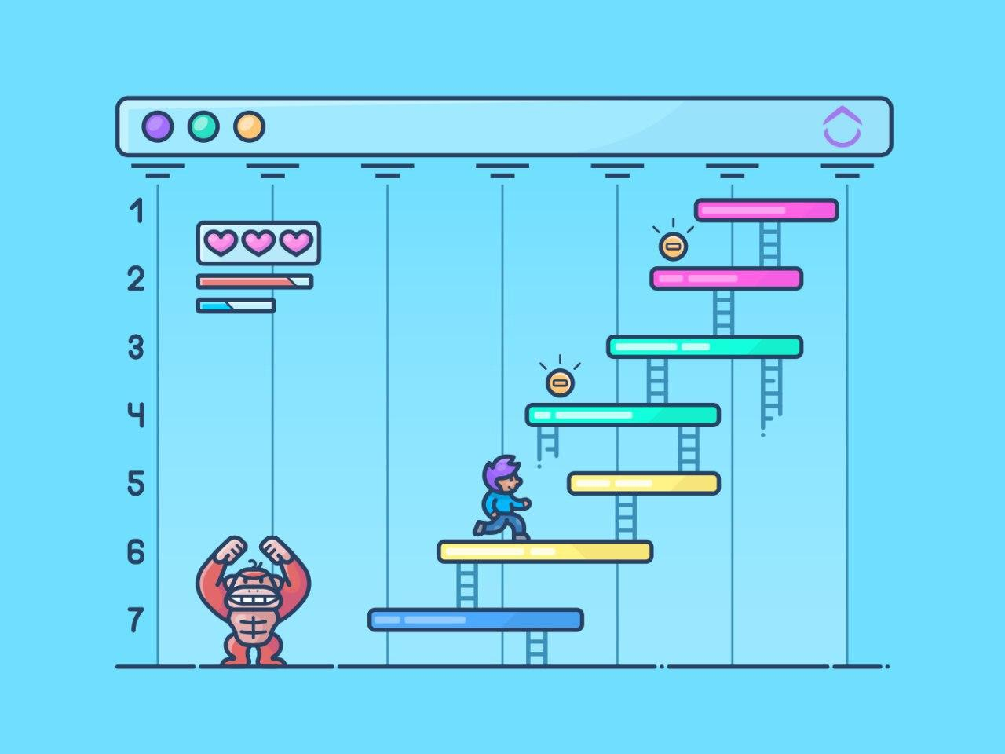
Gantt Chart

Slide 9
February 20 | February 22 | February 25 | February 28 | March 2 | March 3 | March 5 | March 6 | March 9 | March 10
General Meeting
Consumer Poll: Survey and Design Variables |  |  | 1st Meeting | 2nd Meeting |  | 3rd Meeting | ^{4th} Meeting
 |  |  | QFD Analysis |  |  | Choosing among concepts / Decision-making Matrix |  |  | Final Design Confirmation
Conceptual design drafts |  |  |  | Conceptual design drafts |  |  |  | Digital drawings
 |  |  |  |  |  | Report and PPT done

Slide 10
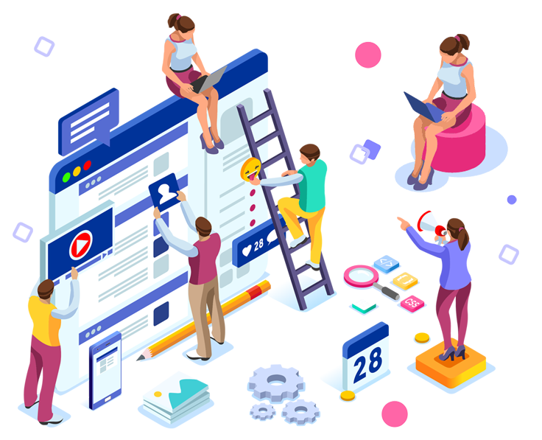
Design Variables

Slide 11
Design Variables
The List Of Essential Features
1
Convenience
The user must feel comfortable to use the product
2
Weight
The product must be lightweight, and should not make any difficulty to lift.
3
Safety
Should hold the user in slippery surfaces
4
Size
The stick must be normal sized
5
More functions
Add some new features for well being
6
Design
The design should make the product more flexible and should fit the hand

Slide 12
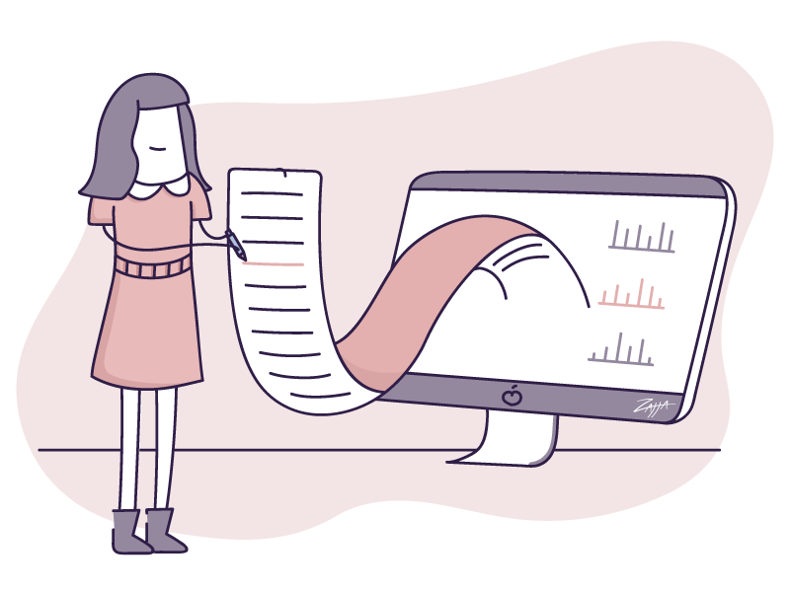
QFD Analysis

Slide 13
 | Easy to use | Does not disturb normal walking | Multi functioning | C O S T | S A F E T Y | D U R A B L E | Energy consumption | Light W E I G H T | D E S I G N | T O T A L
C1 | 9 | 6 | 3 | 9 | 9 | 7 | 2 | 8 | 1 | 54
C2 | 7 | 4 | 5 | 8 | 7 | 6 | 7 | 6 | 6 | 56
C3 | 6 | 3 | 9 | 2 | 7 | 2 | 9 | 7 | 7 | 52
C4 | 8 | 5 | 4 | 8 | 8 | 7 | 3 | 9 | 3 | 55
C5 | 7 | 6 | 5 | 7 | 7 | 3 | 6 | 7 | 8 | 56
C6 | 7 | 5 | 6 | 6 | 7 | 5 | 4 | 8 | 5 | 53
C7 | 8 | 7 | 2 | 7 | 8 | 9 | 2 | 6 | 9 | 58
C8 | 6 | 4 | 3 | 9 | 6 | 5 | 1 | 5 | 4 | 43
Total | 58 | 40 | 37 | 56 | 59 | 44 | 34 | 56 | 43

Slide 14
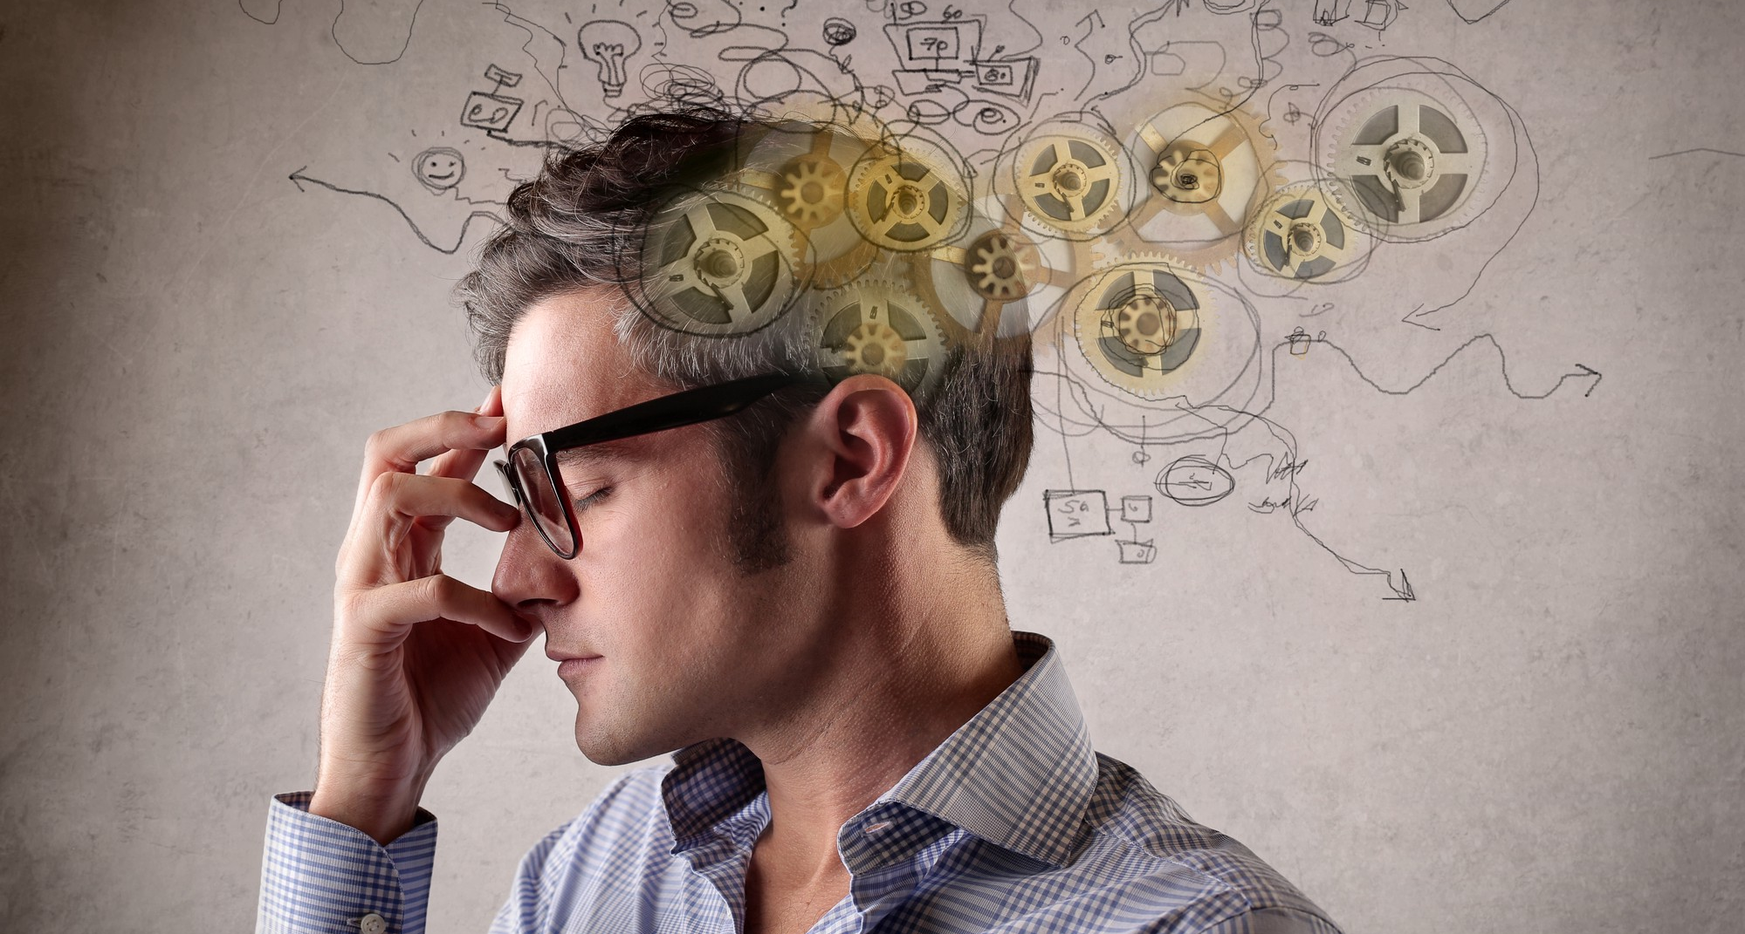
Conceptual Design
How It works?
Examples of biomimicry in use.

Slide 15
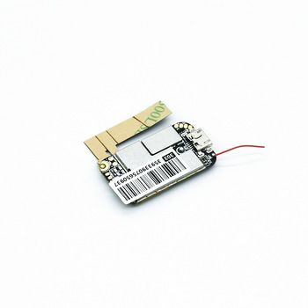
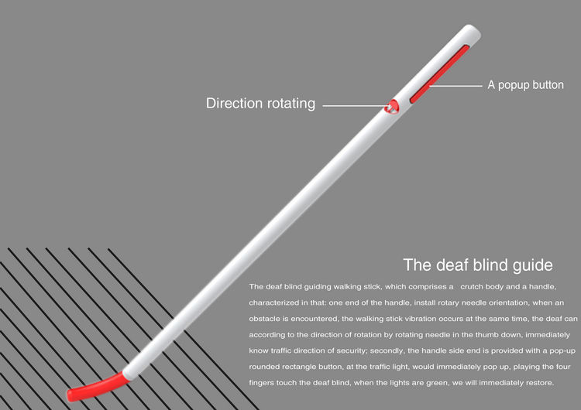
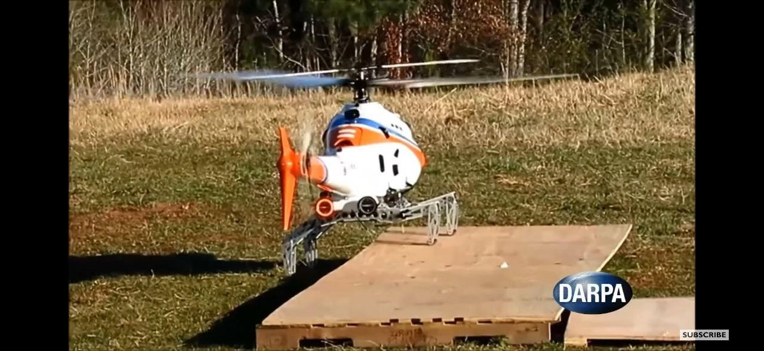
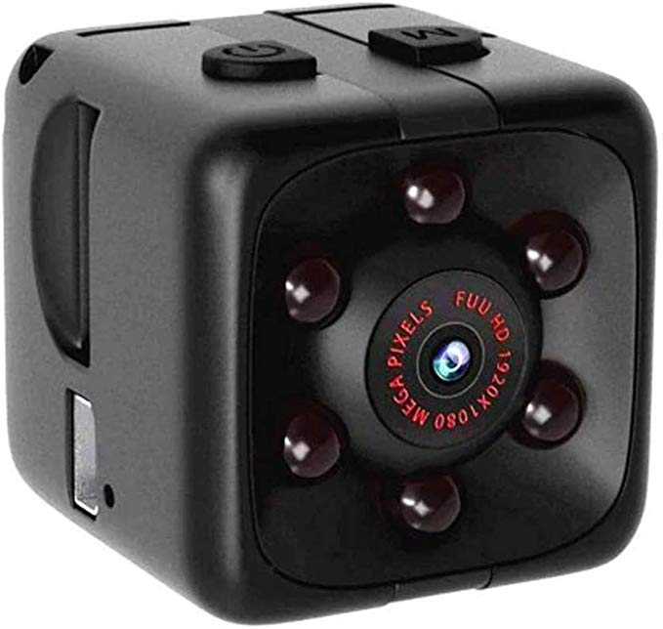
Details, Features
20$
17$
15$
10$
Leg stabilization
is the same as
dragonflies have.
Built in GPS
Navigator for
Tracking.
The camera for
identifying the
traffic lights.
The ready product
as a base for the
new one.

Slide 16
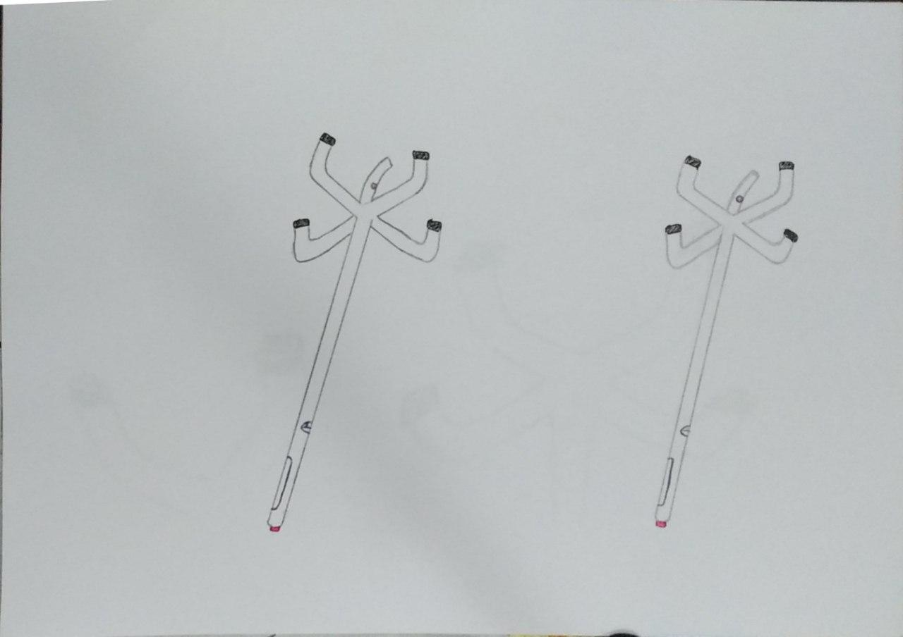
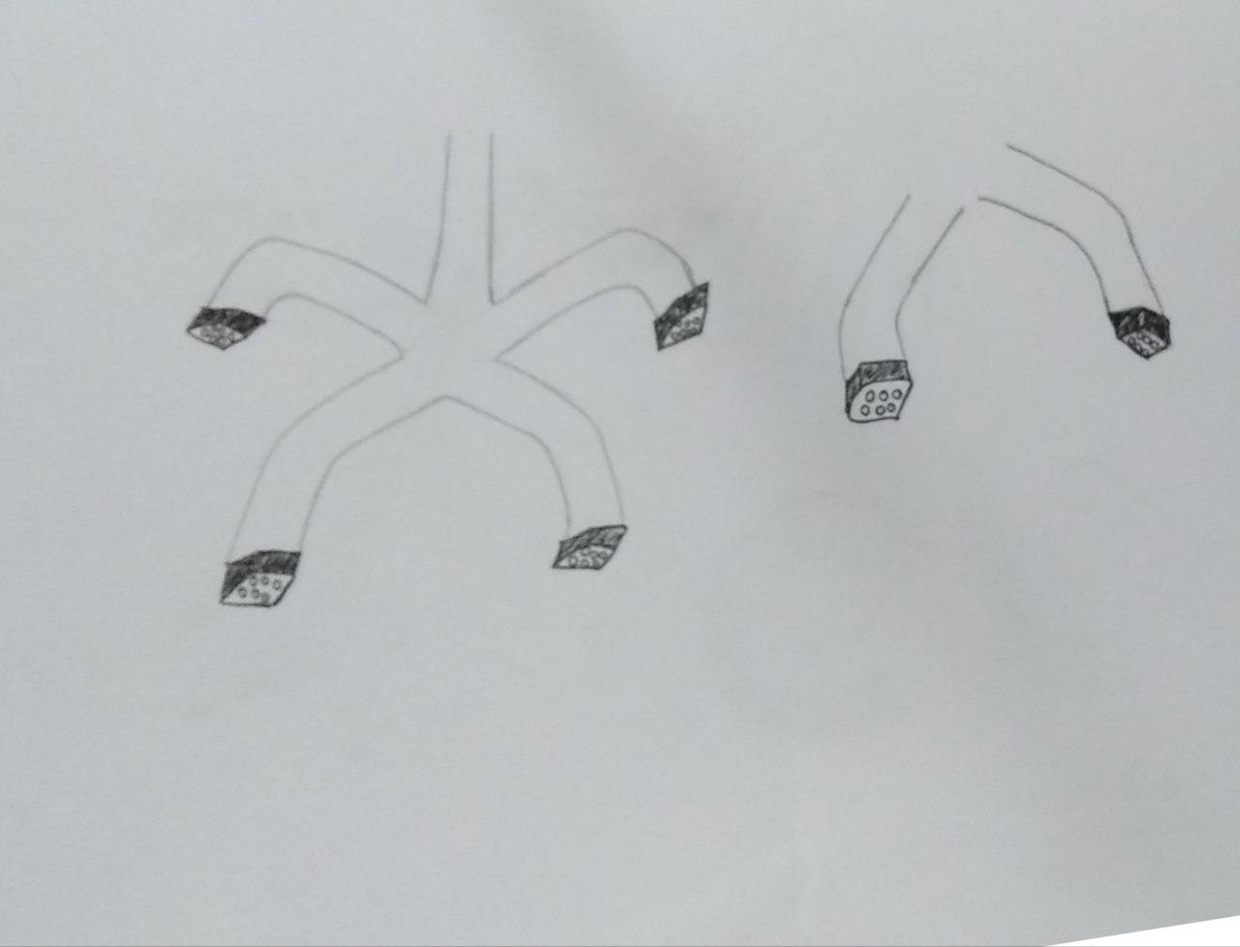

Slide 17
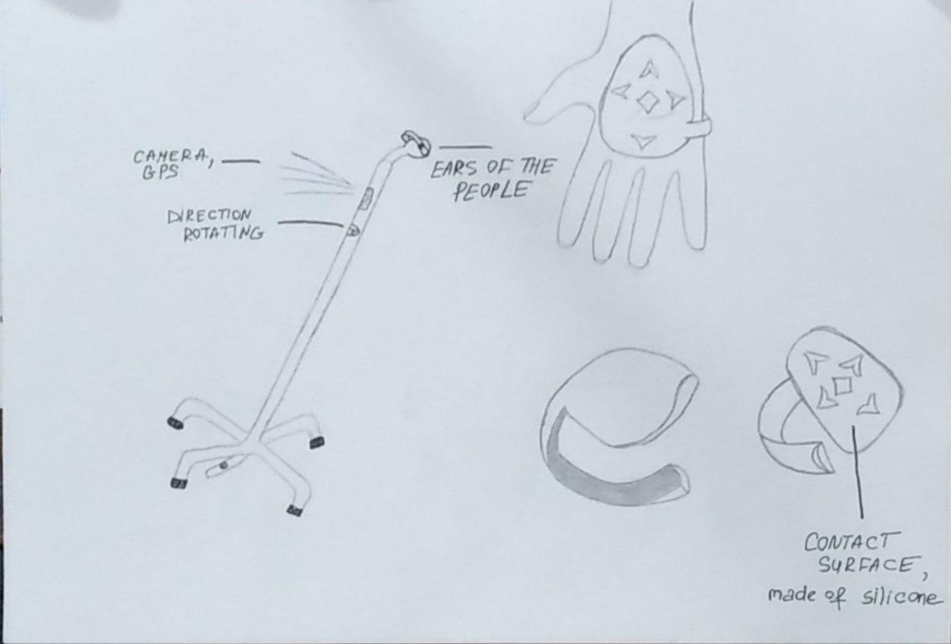

Slide 18

Decision-Making Matrix

Slide 19
 | EASY TO USE | COST | SAFITY | Light WEIGHT | Total
C2 | 7 | 8 | 7 | 6 | 28
C4 | 8 | 8 | 8 | 9 | 33
C5 | 7 | 7 | 7 | 7 | 28
C7 | 8 | 7 | 8 | 6 | 29

Slide 20
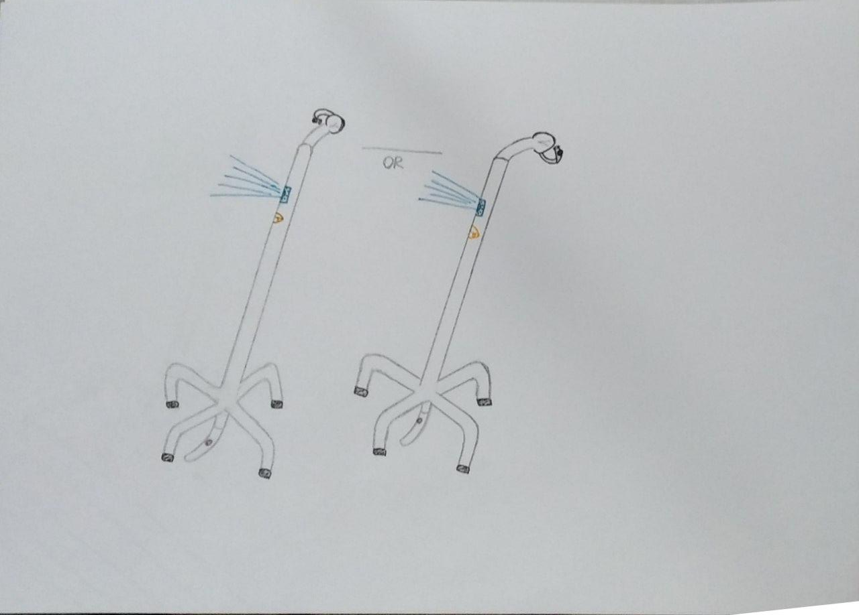
Final Design

Slide 21
Evaluation
With the help of four legs the stick will be much more prone to the stabilization, so that the person using it will have less chance to fall in different surfaces.
Thanks to the elastic on the surface side of the legs, the user will be much more convenient to walk in snow, rain, and some slippery surfaces. And the toggle button which will even make it better, so that the thorns will go inside when not needed.
The stick has built in camera that will help with the traffic lights and tell the user when to stop and walk with the help of vibrations. The advantage of this stick among others is that the user will not need any phone and a special app for this.

Slide 22
Evaluation
With the help of sensor and the vibration the user will know about the upcoming obstacles.
The biomimicry has helped us to form the idea about the legs of the stick and to stabilize it.
The blind people and the ones who can not hear will start feeling at least some comfort in their lives using this stick and it will help them in a lot of situations.

Slide 23
Thanks For The Attention

